Slide 1


Presentation on Quiz System
Guided By: Presented By:
Prof. Varsha Choudhary Hariom Mandloi(0827CD221033)
Shubham Siloriya(0827CD221068)
Deepak Patel(0827CD221023)
Deepak Patel(0827CD221024)

Slide 2
Contents
Introduction
1.1 Overview
1.2 Purpose
Requirement Engineering
2.1 Requirement Collection
2.2 Functional Requirements
2.3 Non Functional Requirements
2.4 Use Case Diagram
Technical Design
3.1 Technical Architecture
3.2 Sequence Diagram
3.3 Class Diagram
3.4 DFD
User Interface Design
Data Design
5.1 Schema Design
5.2 E-R Diagram
REFERENCES

Slide 3
1. Introduction
1.1 Overview
The Online Quiz System is a web-based application designed to conduct quizzes efficiently in a digital format, eliminating the need for paper-based assessments.
It provides an easy-to-use interface for users to attempt multiple-choice questions and receive immediate results.
The system includes an admin panel that allows quiz creators to add, manage, and update questions securely.
1.2 Purpose
To provide a digital platform for conducting quizzes efficiently and conveniently.
To enable instant result generation and reduce manual effort in evaluation.
To allow administrators to manage quiz content securely and systematically.

Slide 4
2. Requirement Engineering 2.1 Requirement Collection
Interviews:- Direct discussions with stakeholders (teachers, students, administrators) to understand their needs, expectations, and challenges with existing systems.
Questionnaires/Surveys:- Useful for collecting input from a larger group of potential users by asking specific questions about desired features and user preferences.
Observation Studying:- how quizzes are currently conducted (either manually or digitally) to identify pain points and improvement areas.
Document Analysis:- Reviewing existing quiz systems or related software documentation to understand standard features, limitations, and user feedback.

Slide 5
2.2 Function Requirements
Users should be able to log in or register (if user authentication is implemented).
Admin should be able to securely log in to manage quizzes.
Admin can add, edit, or delete quiz questions and manage quiz content.
Users can select and take a quiz with multiple-choice questions.
The system should allow users to submit their quiz after completion.
Results should be calculated and displayed instantly after submission.
All quiz data, including questions, user responses, and scores, should be stored in a database.

Slide 6
2.2 Non Functional Requirements
The interface should be user-friendly and easy to navigate.
The application should perform efficiently with quick response times.
Security measures should be in place to protect admin access and user data.
The system should be scalable to support future enhancements or increased user load.
It should be compatible with different devices and browsers.
The system should be maintainable and easily upgradable when needed.

Slide 7
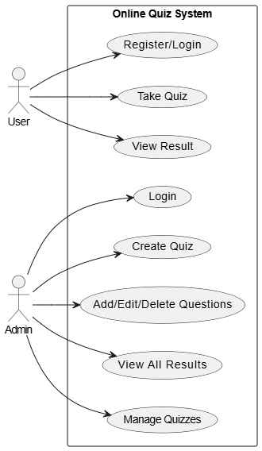
2.3 Use Case Diagram

Slide 8
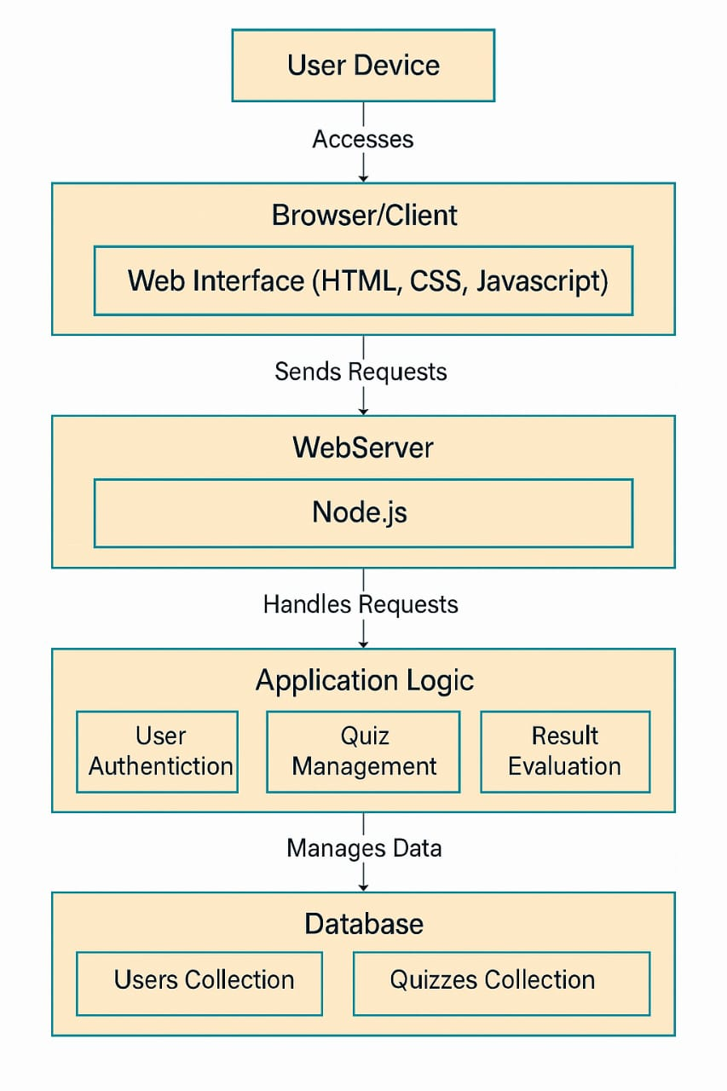
3. Technical Design 3.1 Technical Architecture

Slide 9
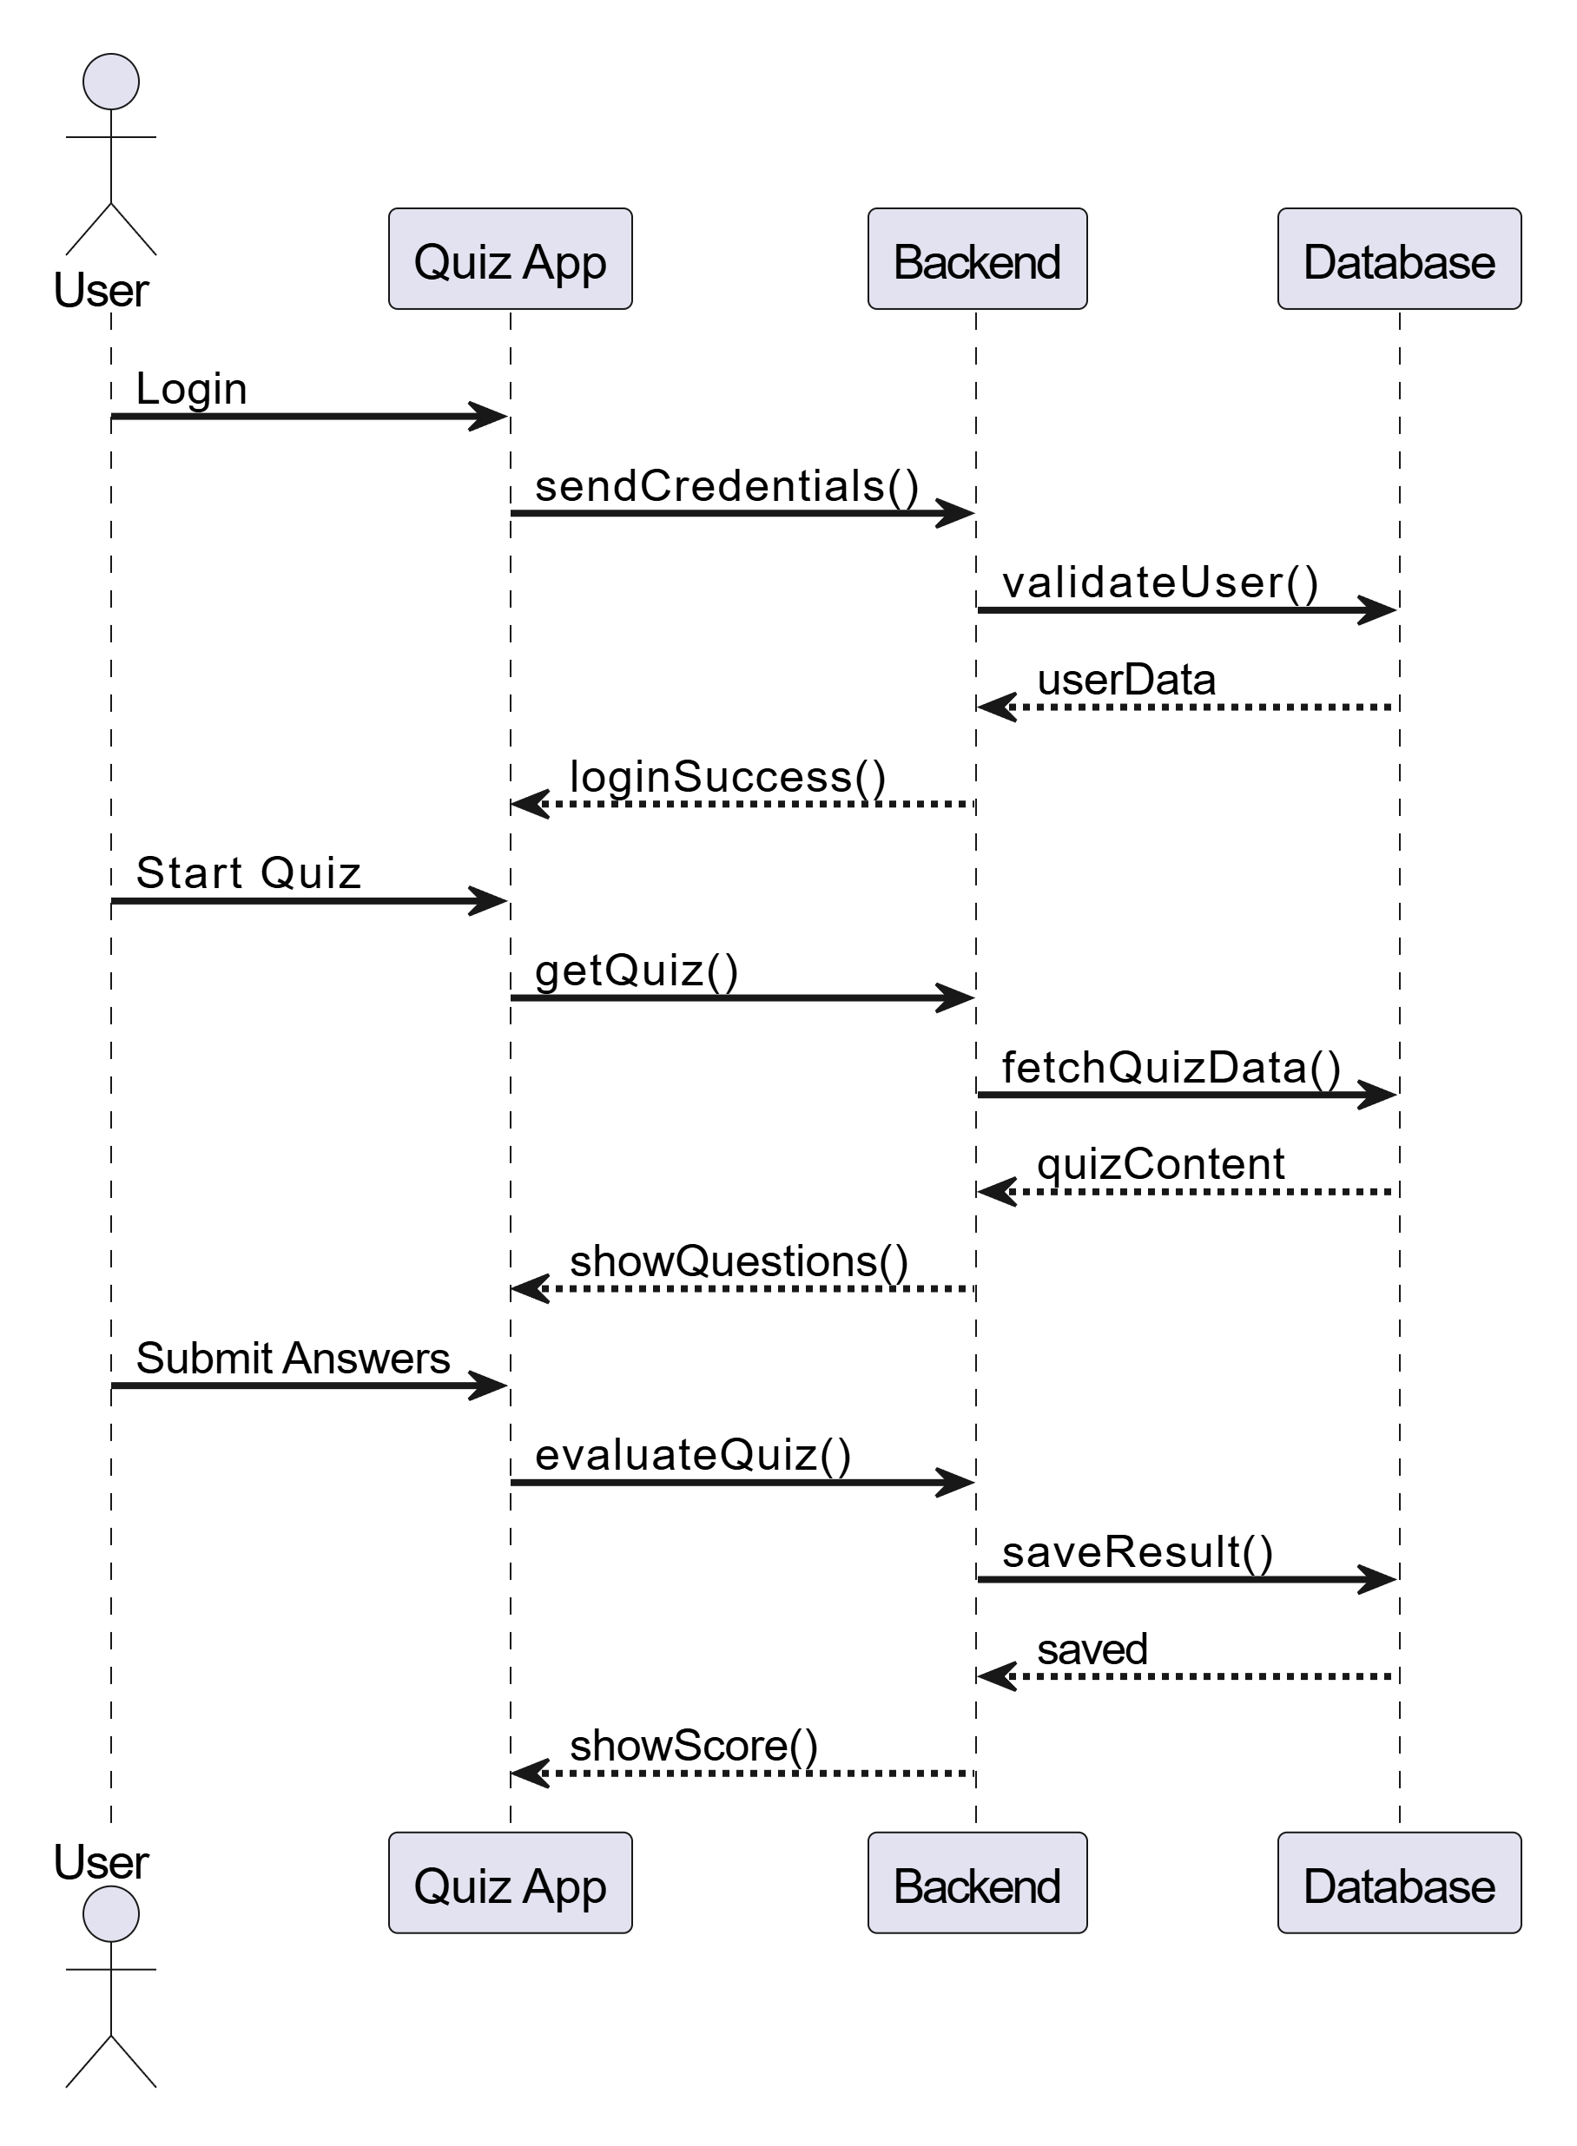
3.2 Sequence Diagram

Slide 10
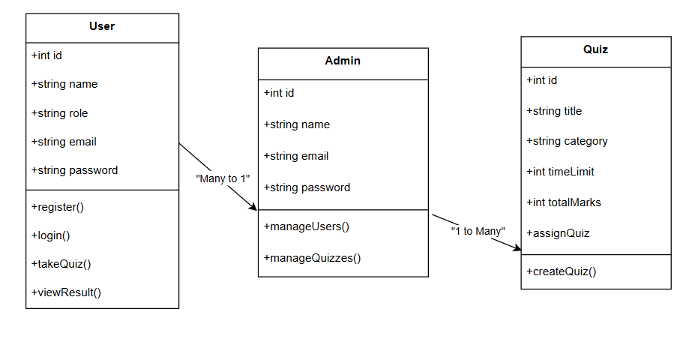
3.3 Class Diagram

Slide 11
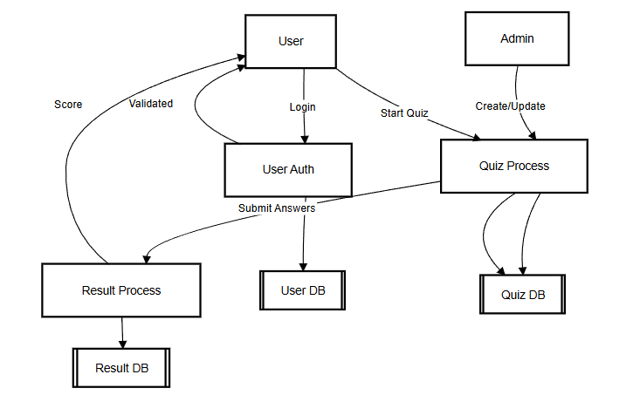
3.4 DFD

Slide 12
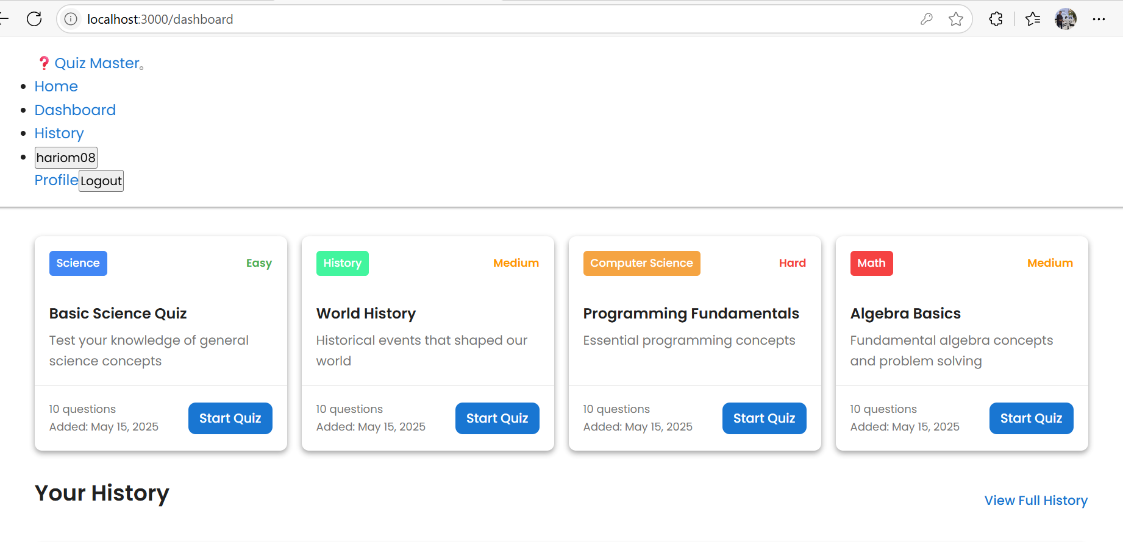
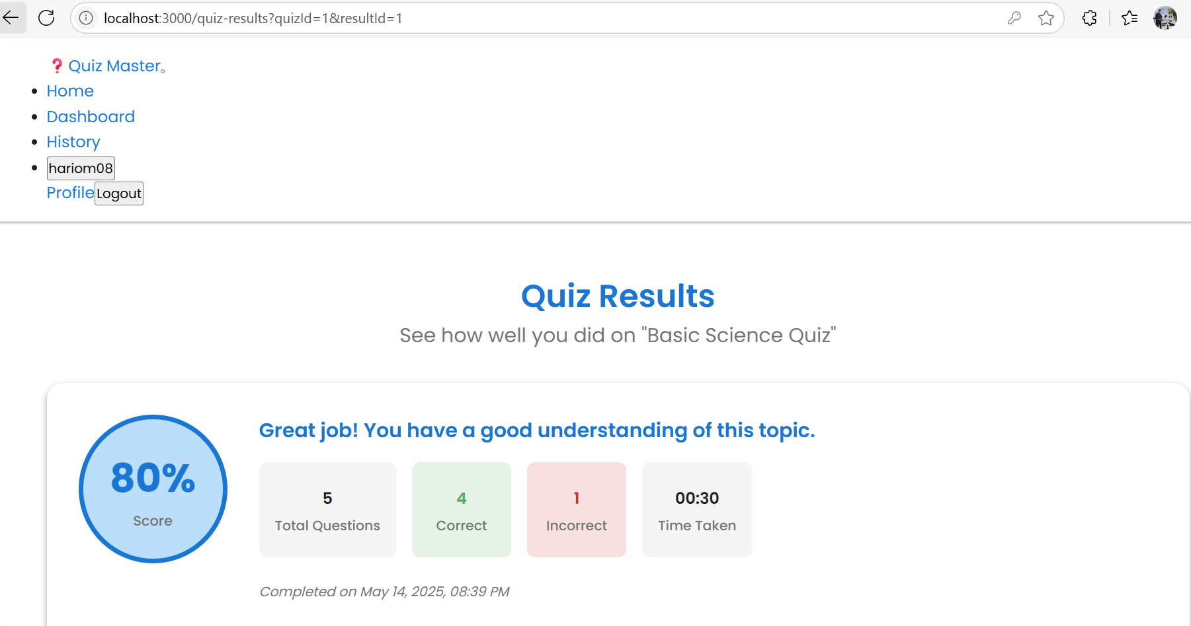
4. User Inface Design

Slide 13
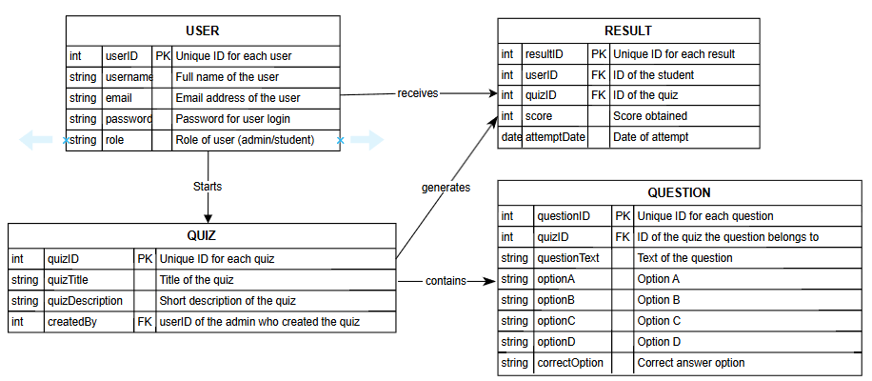
4. Data Design 4.1 Schema Definition

Slide 14
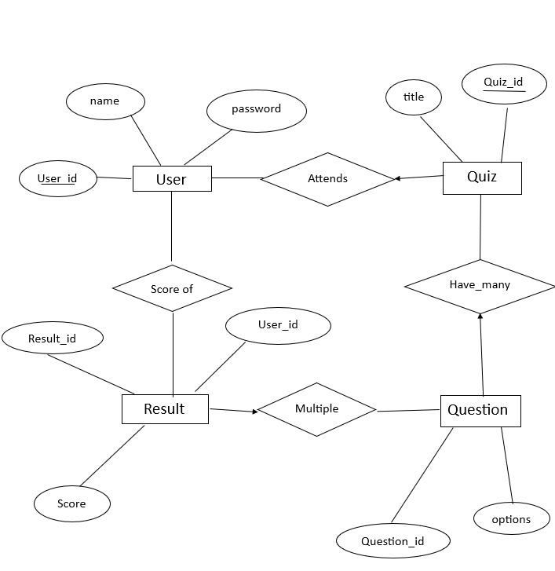
4.2 E-R Diagram

Slide 15
GitHub Link
https://github.com/hariiom08/Minor-project-2

Slide 16
REFERENCES
[1] Moodle Documentation – Moodle Quiz Module, https://docs.moodle.org
[2] Google Forms Help – Create a quiz with Google Forms, https://support.google.com
[3] Black, P., & Wiliam, D. (1998). Assessment and classroom learning. Assessment in Education: Principles, Policy & Practice, 5(1), 7–74.

Slide 17
[4] Anderson, L. W., & Krathwohl, D. R. (2001). A Taxonomy for Learning, Teaching, and Assessing: A Revision of Bloom's Taxonomy of Educational Objectives.
[5] Kahoot! – Game-based learning platform, https://kahoot.com

Slide 18
Thank You
Queries ?

